Slide 1
Code Review Practices
Prof. Dr. Dirk Riehle
Friedrich-Alexander University Erlangen-Nürnberg
AMOS F01
Licensed under CC BY 4.0 International
Notes:
It is Friedrich-Alexander University Erlangen-Nürnberg – FAU, in short.
Corporate identity wants us to say “Friedrich-Alexander University”.

Slide 2
Traditional to Scrum Role Mapping (Recap)
Traditional
Scrum
Product Manager
Product Owner
Engineering Manager
Software Developer
Software Developer
Scrum Master
QA Engineer

Slide 3
Code Review
Definition and purpose
  “Code review is systematic examination […] of computer source code.
    It is intended to find and fix mistakes overlooked in the initial development phase,
      improving both the overall quality of software
      and the developers’ skills.
  Reviews are done in various forms such as
    pair programming,
    informal walkthroughs, and
    formal inspections.” [1]
[1] Adapted from https://en.wikipedia.org/wiki/Code_review [DR]

Slide 4
When to Review Code?
In the moment
Before commit
At another time
Before release

Slide 5
Pair Programming
Definition
  Is programming carried out by pairs of programmers
  One programmer implements, and the other programmer reviews
  Effectiveness is debated; empirical studies show conflicting evidence
Purpose
  Quality assurance
  Collaborative learning
  Knowledge sharing
Synonyms
  Programmer and reviewer
  Driver and co-driver
  Pilot and navigator

Slide 6
Agile Code Review Practices
Pair programming
Pre-commit code review

Slide 7


Pair Programming (Practices)
Process
  Find comfortable partner
  Switch roles often
  Communicate regularly
Advice
  Don’t force it for small stuff
  Don’t overheat, take a break
  Switch partners at times

Slide 8
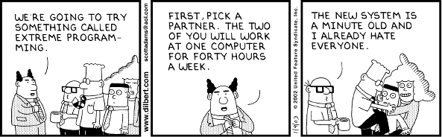
Dilbert on Pair Programming 1 / 2

Slide 9
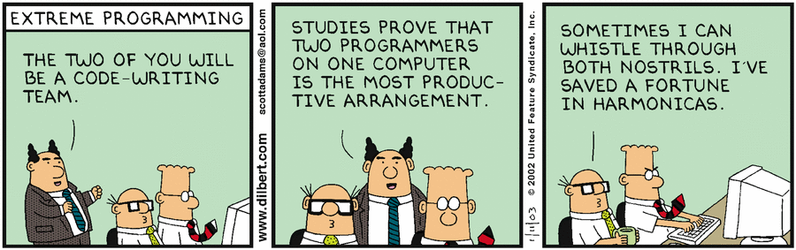
Dilbert on Pair Programming 2 / 2

Slide 10
Pre-Commit Code Review
Code review
  Is the (peer) review of source code for quality criteria
  Reviewer has accept or reject responsibility
  Cf. “Vier-Augen-Prinzip” (in German)
Pre-commit code review
  Is the review of source code before it gets committed to a team repository
  Typically facilitated by a software tool, e.g. Gerrit
  May lead to back and forth between developers until “LGTM”

Slide 11
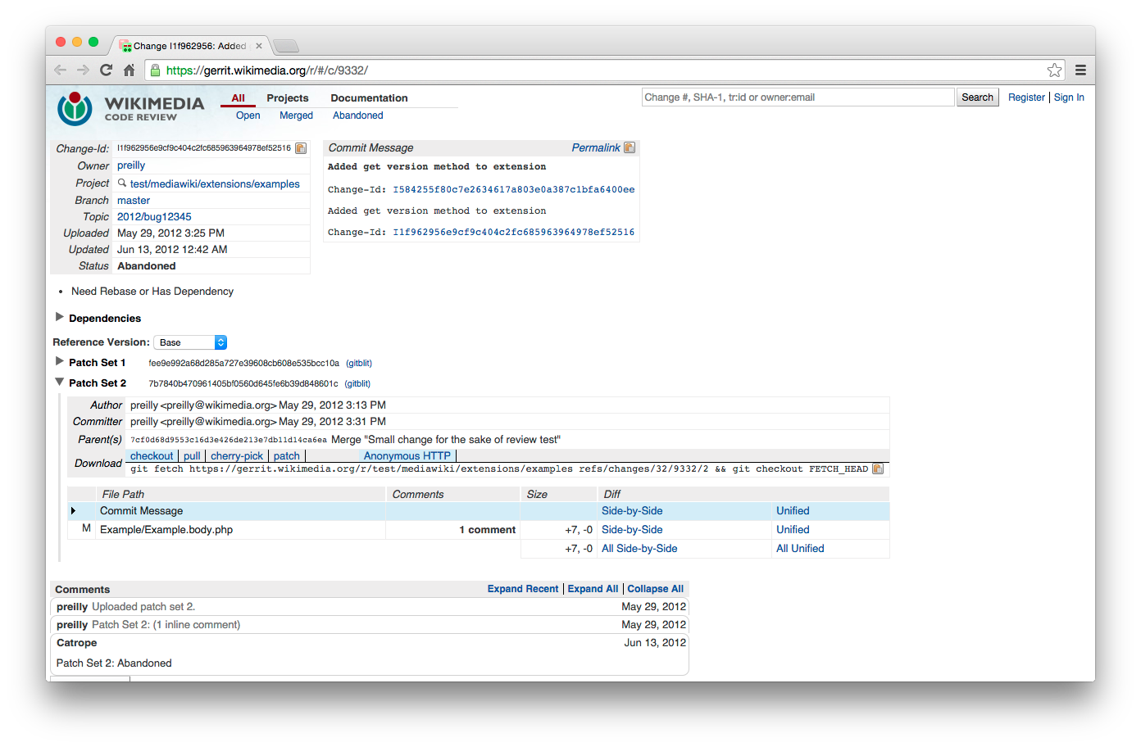
Example Code Review with Gerrit 1 / 3
[1] See https://www.mediawiki.org/wiki/Gerrit/Tutorial

Slide 12
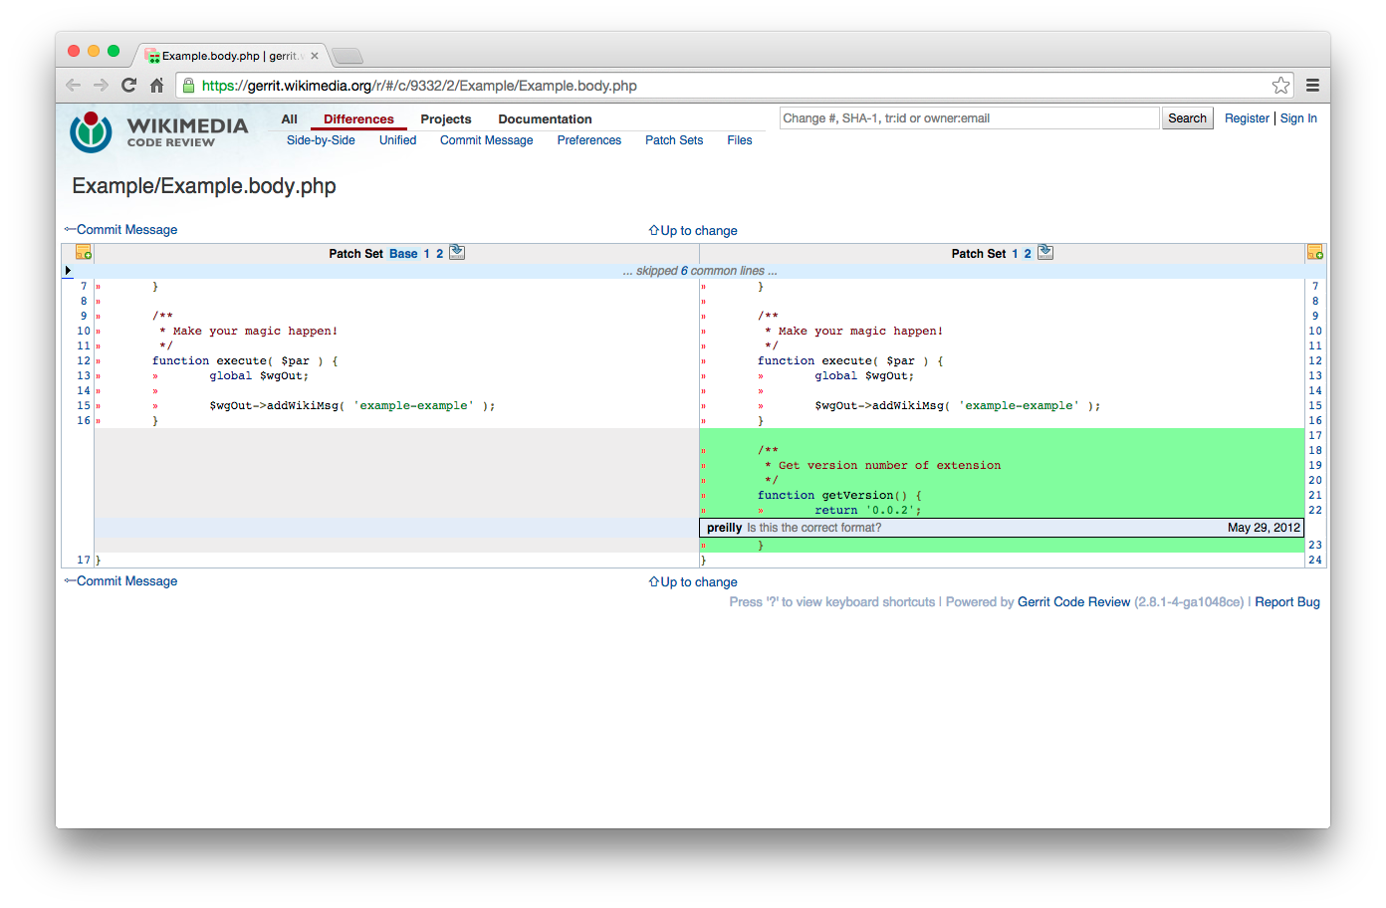
Example Code Review with Gerrit 2 / 3

Slide 13
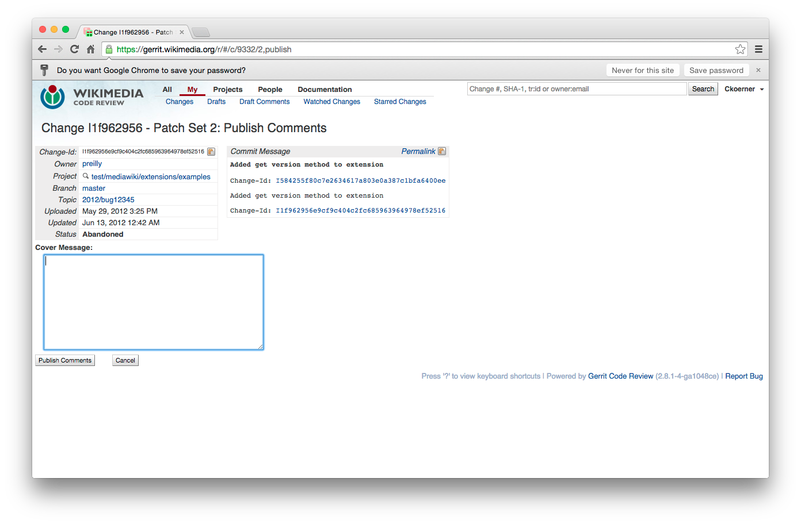
Example Code Review with Gerrit 3 / 3

Slide 14
Benefits of Pre-commit Code Review
Collaboration
  Improves knowledge sharing and teamwork
  Makes it easier to establish topics like security
Quality assurance
  Leads to more disciplined developers
  Prevents (some) errors before they happen
  Raises overall quality standards
Feeling of responsibility
  Specifically, supports collective code ownership
  Strengthens overall feeling of responsibility

Slide 15
Agile vs. Open Source Code Review
Agile methods
  Programming guidelines
    Code reading >> writing
    Make it easy to get acquainted
  Collective code ownership
    Feature-oriented development
    Typically co-located development
    Everyone has write access
  Pair programming
    Changes are reviewed directly
    Everyone is a peer
Open source
  Programming guidelines
    Code reading >> writing
    Showing respect for project
  Individual code ownership
    Component-oriented development
    Typically distributed development
    Strictly regulated write access
  Patch review
    Changes are submitted for review
    Two-class reviewing hierarchy

Slide 16
Review / Summary of Session
Code review practices
  Pair programming
  Pre-commit code review
Agile vs. open source approach

Slide 17
Thank you! Questions?
dirk.riehle@fau.de – http://osr.cs.fau.de
dirk@riehle.org – http://dirkriehle.com – @dirkriehle
DR

Slide 18
Credits and License
Original version
  © 2012-2019 Dirk Riehle, some rights reserved
  Licensed under Creative Commons Attribution 4.0 International License
Contributions
  ...

